Slide 1

Introduction to Microsoft Intune and Microsoft Endpoint Manager for Public Cloud
MODULE 03
Dr. Rigoberto Garcia

Slide 2

What is Microsoft Endpoint Manager?
Microsoft Endpoint Manager, you accomplish the following actions:
Protect the data that the people at your organization are accessing.
Ensure your organization is using proper credentials to access and share company data.
Safeguard the devices and apps that access your organization resources.
Ensure that new members of your organization have a great experience on-boarding to your organization.
Confirm security rules are in place based on your organizations requirements.
Confirm that every member of your organization has a device that is configured and protected.
Ensure that all your corporate services are easily available to end users on all the devices they use.
Ensure that end users get the best possible experience based on first class support for all the products that they need to use.
Notes:
Microsoft Endpoint Manager is a single, integrated management platform for managing, protecting, and monitoring all of your organization's endpoints.
Endpoints include the mobile devices, desktop computers, virtual machines, embedded devices, servers, and shared devices that your organization uses. Examples of shared and specialized devices include retail point of sale devices, ruggedized devices, digital interactive whiteboards, conference room devices, and holographic wearable computers. Additionally, endpoints also include the apps used by your organization.
By protecting and managing your organization's endpoints using Microsoft Endpoint Manager, you accomplish the following actions:
Protect the data that the people at your organization are accessing.
Ensure your organization is using proper credentials to access and share company data.
Safeguard the devices and apps that access your organization resources.
Ensure that new members of your organization have a great experience on-boarding to your organization.
Confirm security rules are in place based on your organizations requirements.
Confirm that every member of your organization has a device that is configured and protected.
Ensure that all your corporate services are easily available to end users on all the devices they use.
Ensure that end users get the best possible experience based on first class support for all the products that they need to use.
The Microsoft Endpoint Manager console helps keep your organization's cloud and on-premises devices, apps, and data secure. Endpoint Manager integrates Microsoft Intune, Microsoft Endpoint Configuration Manager, Desktop Analytics, and Windows Autopilot.
Important
If you already have Microsoft Intune or Microsoft Endpoint Configuration Manager you already have Microsoft Endpoint Manager. These are all now one management system.

Slide 3
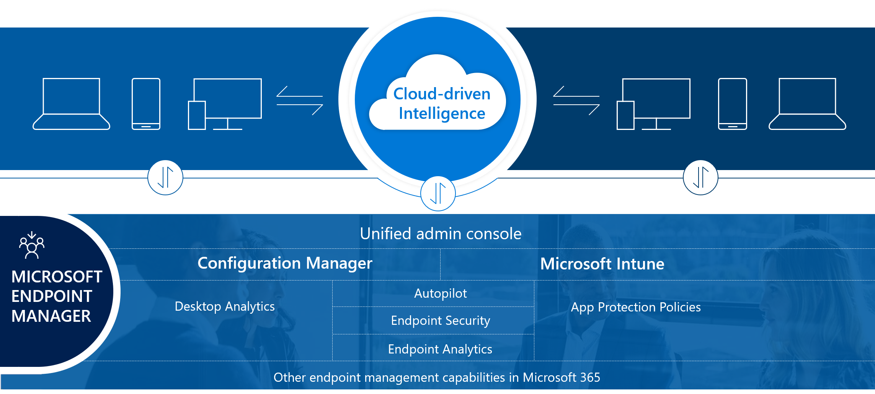
MEM – Cloud Driven Intelligence
Notes:
To quickly step through the areas of Microsoft Endpoint Manager, see Tutorial: Walkthrough Intune in Microsoft Endpoint Manager.

Slide 4

Understand Microsoft Intune for Azure Pubic
LESSON 1

Slide 5

What is Microsoft Intune?
Microsoft Intune is about Management of MDM and MAM
Protect your organization by controlling features and settings on:
Android,
Android Enterprise,
iOS/iPadOS, macOS, and
Windows 10/11 devices.
Notes:
Microsoft Intune, which is a part of Microsoft Endpoint Manager, provides the cloud infrastructure, the cloud-based mobile device management (MDM), cloud-based mobile application management (MAM), and cloud-based PC management for your organization. It lets you protect your organization by controlling features and settings on Android, Android Enterprise, iOS/iPadOS, macOS, and Windows 10/11 devices. It integrates closely with Azure Active Directory (Azure AD) for identity and access control and Azure Information Protection and advanced threat protection products for data protection. When you use it with Microsoft 365, you can enable your workforce to be productive on all their devices while keeping your organization's information protected. If you have on-premises infrastructure, such as Exchange or an Active Directory, you can use Intune connectors to help you connect to external services. Intune, which is a part of Microsoft Endpoint Manager, is included in Microsoft's Enterprise Mobility + Security (EMS) suite.

Slide 6
Intune Modern Device Management
Microsoft Enterprise Mobility + Security(EMS) suite I
Integrates with Azure Active Directory (Azure AD)
Integrates with Microsoft 365 suite of products.
Can Deploy:
Microsoft Teams,
Microsoft Outlook,
Microsoft OneDrive,
OneNote, and
Other Microsoft 365 Apps to devices
Integrates with Azure Information Protection for data protection
Notes:
Intune is part of Microsoft's Enterprise Mobility + Security (EMS) suite. Intune integrates with Azure Active Directory (Azure AD) to control who has access and what they can access. It also integrates with Azure Information Protection for data protection. It can be used with the Microsoft 365 suite of products. For example, you can deploy Microsoft Teams, OneNote, and other Microsoft 365 apps to devices. This feature enables people in your organization to be productive on all of their devices while keeping your organization’s information protected with the policies you create.

Slide 7
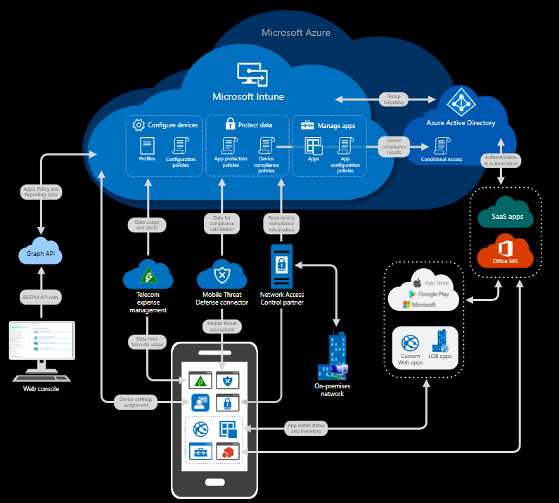
With Intune, you can:
Choose to be 100% cloud with Intune or be co-managed with Configuration Manager and Intune.
Set rules and configure settings on personal and organization-owned devices to access data and networks.
Deploy and authenticate apps on devices -- on-premises and mobile.
Protect your company information by controlling the way users access and share information.
Be sure devices and apps are compliant with your security requirements.

Slide 8

Manage devices
When devices are enrolled and managed in Intune, administrators can:
See the devices enrolled and get an inventory of devices accessing organization resources.
Configure devices, so they meet your security and health standards. For example, you probably want to block jailbroken devices.
Push certificates to devices so users can easily access your Wi-Fi network or use a VPN to connect to your network.
See reports on users and devices compliance.
Remove organization data if a device is lost, stolen, or not used anymore.
Notes:
In Intune, you manage devices using an approach that's right for you. For organization-owned devices, you may want full control over the devices, including settings, features, and security. In this approach, devices and users of these devices "enroll" in Intune. Once enrolled, they receive your rules and settings through policies configured in Intune. For example, you can set password and PIN requirements, create a VPN connection, set up threat protection, and more.
For personal devices, or bring-your-own devices (BYOD), users may not want their organization administrators to have full control. In this approach, give users options. For example, users enroll their devices if they want full access to your organization's resources. Or, if these users only want access to email or Microsoft Teams, then use app protection policies that require multi-factor authentication (MFA) to use these apps.

Slide 9
Manage apps
When apps are managed in Intune, administrators can:
Add and assign mobile apps to user groups and devices, including users in specific groups, devices in specific groups, and more.
Configure apps to start or run with specific settings enabled and update existing apps already on the device.
See reports on which apps are used and track their usage.
Do a selective wipe by removing only organization data from apps.
App protection policies:
Use Azure AD identity to isolate organization data from personal data. So personal information is isolated from organizational IT awareness. Data accessed using organization credentials are given additional security protection.
Help secure access on personal devices by restricting actions users can take, such as copy-and-paste, save, and view.
Can be created and deployed on devices that are enrolled in Intune, enrolled in another MDM service, or not enrolled in any MDM service. On enrolled devices, app protection policies can add an extra layer of protection.
Notes:
Manage apps
Mobile application management (MAM) in Intune is designed to protect organization data at the application level, including custom apps and store apps. App management can be used on organization-owned devices and personal devices.
When apps are managed in Intune, administrators can:
Add and assign mobile apps to user groups and devices, including users in specific groups, devices in specific groups, and more.
Configure apps to start or run with specific settings enabled and update existing apps already on the device.
See reports on which apps are used and track their usage.
Do a selective wipe by removing only organization data from apps.
One way that Intune provides mobile app security is through app protection policies. App protection policies:
Use Azure AD identity to isolate organization data from personal data. So personal information is isolated from organizational IT awareness. Data accessed using organization credentials are given additional security protection.
Help secure access on personal devices by restricting actions users can take, such as copy-and-paste, save, and view.
Can be created and deployed on devices that are enrolled in Intune, enrolled in another MDM service, or not enrolled in any MDM service. On enrolled devices, app protection policies can add an extra layer of protection.

Slide 10
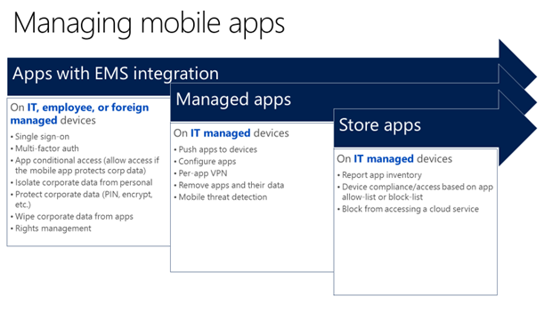
Manage apps
Notes:
For example, a user signs in to a device with their organization credentials. Their organization identity allows access to data that's denied to their personal identity. As that organization data is used, app protection policies control how the data is saved and shared. When users sign in with their personal identity, those same protections aren't applied. In this way, IT has control of organization data, while end users maintain control and privacy over their personal data.
You can also use Intune with the other services in EMS. This feature provides your organization's mobile app security beyond what's included with the operating system and any apps. Apps managed with EMS have access to a broader set of mobile app and data protection features.

Slide 11
Compliance and conditional access
Types of Conditional Access
Conditional access based on network access control
Conditional access based on device risk
Conditional access for Windows PCs
Corporate-owned
Hybrid Azure AD joined
Azure AD domain joined and Intune management
Bring your own device (BYOD)
Workplace join and Intune management
App-based conditional access
Notes:
Compliance and conditional access
Intune integrates with Azure AD to enable a broad set of access control scenarios. For example, require mobile devices be compliant with organization standards defined in Intune before accessing network resources, such as email or SharePoint. Likewise, you can lock down services, so they're only available to a specific set of mobile apps. For example, you can lock down Exchange Online, so it's only accessed by Outlook or Outlook Mobile.
https://docs.microsoft.com/en-us/mem/intune/protect/conditional-access-intune-common-ways-use

Slide 16
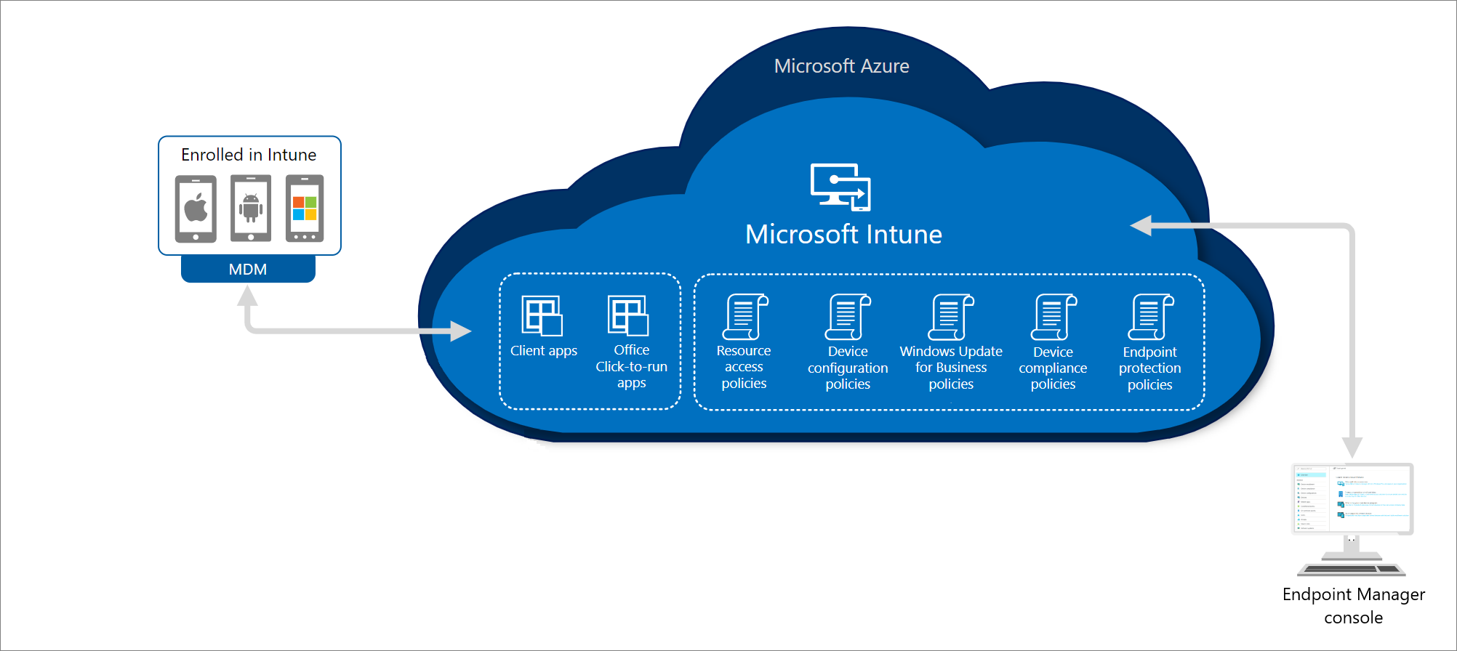
On-premises and Cloud
Notes:
In the following diagram, you can see how Intune interacts with other components in both your on-premises and cloud infrastructure:

Slide 17

Understand Microsoft Endpoint Configuration Manager

Slide 18

What is Microsoft Endpoint Configuration Manager?
Leading PC management solution on the market.
Manage
desktops,
servers, and
laptops on a network or
internet-based solution.
.
Notes:
Microsoft Endpoint Configuration Manager is the leading PC management solution on the market. You use it to manage desktops, servers, and laptops that are on your network or are internet-based. If you use Configuration Manager, you should attach your Configuration Manager deployment to the Microsoft 365 cloud, which will provide integration with Intune, Azure AD, Microsoft Defender ATP, and other cloud services. Use Configuration Manager to deploy apps, software updates, and operating systems, as well as configure sites and clients, and run and monitor management tasks. Configuration Manager supports Windows and macOS versions. The devices you manage with Configuration Manager can run in virtual environments. This includes Hyper-V on Windows servers as well as Virtual Machines (VM) in Azure. If you run a server as an Azure-based VM, you can install the Configuration Manager client on that device.

Slide 19
When to use Configuration Manager?
To use Configuration Manager,
attach your Configuration Manager deployment to the Microsoft 365 cloud,
which will:
provide integration with Intune,
Azure AD,
Microsoft Defender ATP, and
other cloud services.
Use Configuration Manager to:
deploy apps,
software updates,
operating systems,
configure sites
clients,
run and monitor management tasks.

Slide 20

What does MECM support?
Configuration Manager supports:
Windows and
macOS versions.
Device management can be:
Physical, or
Virtual
Hyper-V on Windows servers as well as Virtual Machines (VM) in Azure.
Note: If you run a server as an Azure-based VM, you can install the Configuration Manager client on that device

Slide 21
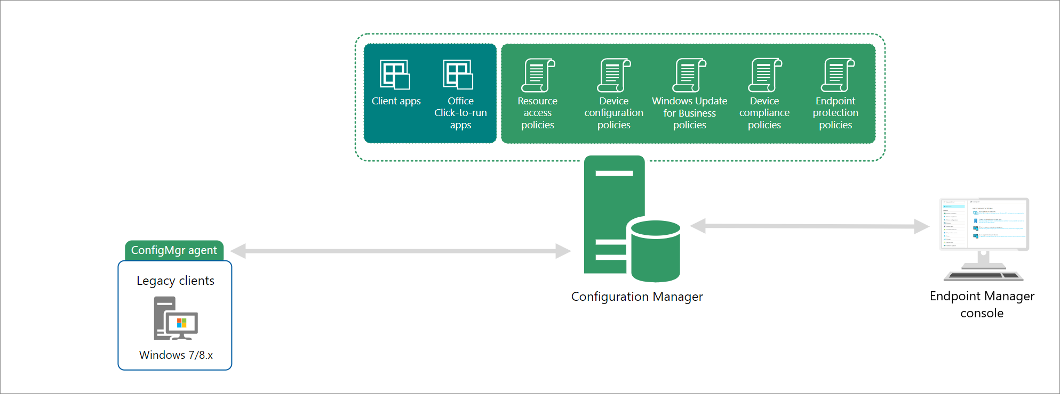
Configuration Management Architecture

Slide 22

Cloud Attach

Slide 23
What is Cloud Attach?
What is cloud attached?
Cloud attach is Configuration Manager only managed devices that show up in the cloud portal.
Notes:
Cloud attach allows you to use both Microsoft Intune and Microsoft Endpoint Configuration Manager from Microsoft Endpoint Manager.
There are two steps to cloud attach your on-premises devices. The first step of attachment is called tenant attach, which is registering your Intune tenant with your Configuration Manager deployment. The second step is called co-management, which is concurrently managing Windows 10/11 devices with both Configuration Manager and Microsoft Intune. These are incremental steps on the journey to having full cloud attachment. You get immediate value through tenant attach and you get extra value through co-management.

Slide 24
Cloud-Attaching On-Prem
Single methods, two steps:
First step of attachment is called tenant attach,
Registers On-Prem into your Intune tenant with your Configuration Manager deployment.
Second step is called co-management,
Current solution for managing Windows 10/11 devices with both Configuration Manager and Microsoft Intune.
Notes:
There are two steps to cloud attach your on-premises devices.
first step of attachment is called tenant attach, which is registering your Intune tenant with your Configuration Manager deployment.
second step is called co-management, These are incremental steps on the journey to having full cloud attachment. You get immediate value through tenant attach and you get extra value through co-management.

Slide 25
Is co-managed the same as cloud attach?
Cloud-Attach
No, Cloud attach is Configuration Manager only managed devices that show up in the cloud portal.
Co-Management
Co-management is fully managed by both Configuration Manager and Microsoft Intune with explicit admin intent on which workload is managed by either Configuration Manager or Intune.
Notes:
Co-management is fully managed by both Configuration Manager and Microsoft Intune with explicit admin intent on which workload is managed by either Configuration Manager or Intune. Cloud attach is Configuration Manager only managed devices that show up in the cloud portal.

Slide 26
What is Tenant attach?
Microsoft Endpoint Manager collects information that falls into three categories:
Identified data
Pseudonymized data
Aggregated data
Important Note: Microsoft only uses customer data to provide you the services you signed up for, Microsoft does not sell any data collected by their service to any third parties for any reason.
Notes:
Tenant attach allows you to recognize your Configuration Manager devices and infrastructure by the Intune cloud service and take actions from Microsoft Endpoint Manager. Once you connect Configuration Manager, you gain instant cloud value. Configuration Manager uses the Configuration Manager connector to enable data flow to Microsoft Endpoint Manager. It requires a connection to an Intune tenant, and doesn't require turning on co-management.
Important
The Microsoft data handling policies are described in the Microsoft Intune Privacy Statement. We only use your customer data to provide you the services you signed up for.
We don't sell any data collected by our service to any third parties for any reason.
The data is all required service data that's needed for the tenant attach connected experience. Required service data includes the following information:
Customer content, which is content you create. For example, the name of your LOB application.
Functional data, which includes information needed by a connected experience to perform its task. For example, configuration information about the app.
Service diagnostic data, which is the data necessary to keep the service secure, up to date, and performing as expected. Because this data is strictly related to the connected experience, it's separate from required or optional diagnostic data levels.

Slide 27
What is co-management?
There are two main paths to reach co-management:
Existing Configuration Manager clients
New internet-based devices
Enrollment
Conditional Access with device compliance
Intune-based remote actions, such as restart, remote control, or factory reset
Centralized visibility of device health
Link users, devices, and apps with Azure Active Directory (Azure AD)
Modern provisioning with Windows Autopilot
Notes:
Co-management is where you concurrently manage Windows 10/11 devices with both Configuration Manager and Microsoft Intune. It combines your existing on-premises Configuration Manager and Active Directory investment with the cloud by using Intune, Azure AD, and other Microsoft 365 cloud services. You choose whether Configuration Manager or Intune is the management authority. You keep some tasks on-premises, while running other tasks in the cloud with Intune.
There are two main paths to reach co-management:
Existing Configuration Manager clients: You have Windows 10/11 devices that are already Configuration Manager clients. You set up hybrid Azure AD, and enroll them into Intune.
New internet-based devices: You have new Windows 10/11 devices that join Azure AD and automatically enroll to Intune. You install the Configuration Manager client to reach a co-management state.
When you enroll existing Configuration Manager clients in co-management, you gain the following immediate value:
Conditional Access with device compliance
Intune-based remote actions, such as restart, remote control, or factory reset
Centralized visibility of device health
Link users, devices, and apps with Azure Active Directory (Azure AD)
Modern provisioning with Windows Autopilot
In the following diagram, you can see how Windows 10/11 devices can be managed with both Configuration Manager and Microsoft Intune:

Slide 28
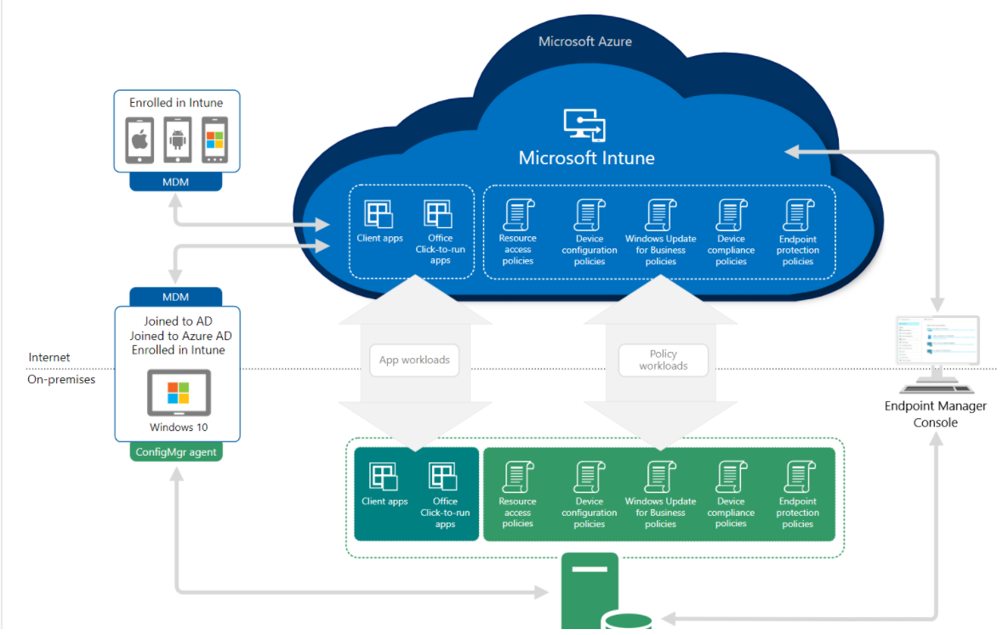
Co-management
Notes:
In the following diagram, you can see how Windows 10/11 devices can be managed with both Configuration Manager and Microsoft Intune:

Slide 29

Understand Desktop Analytics
Microsoft Endpoint Manager

Slide 30
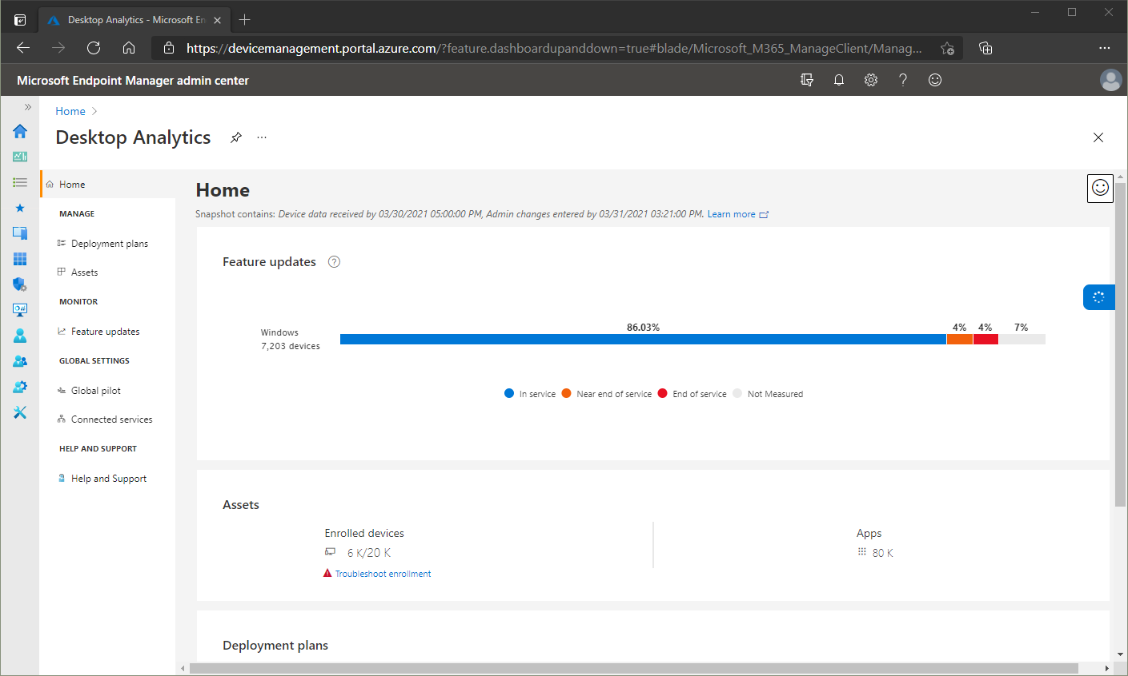
What is Desktop Analytics?
With Configuration Manager
Create an inventory of apps running in your organization
Assess app compatibility with the latest Windows 10 feature updates
Identify compatibility issues, and receive mitigation suggestions based on cloud-enabled data insights
Create pilot groups that represent the entire application and driver estate across a minimal set of devices
Deploy Windows 10 to pilot and production-managed devices
Notes:
Desktop Analytics is a cloud-based service that integrates with Configuration Manager to help you update devices. It provides insight and intelligence for you to make more informed decisions about the update readiness of your Windows clients. The service combines data from your organization with data aggregated from millions of devices connected to the Microsoft cloud. It provides information on apps, and devices in your organization, identifies compatibility issues with apps and drivers, suggest mitigations based on cloud enabled data insights, and create pilots that represent the entire application and driver state across a minimal set of devices.

Slide 31
Analytical Journey
History
Desktop analytics is a successor of Windows Analytics, which retired on January 21, 2020
Benefits
Device and software inventory
Pilot identification
Issue identification
Configuration Manager integration
Notes:
Many customers have challenges with getting and staying current with Windows 10. The primary challenge is testing applications. This process is typically manual. It's time-consuming for IT administrators and application owners to continually analyze existing applications. Then remediate any issues that arise.
Desktop Analytics provides the following benefits:
Device and software inventory: Inventory of key factors such as apps and versions of Windows.
Pilot identification: Identification of the smallest set of devices that provide the widest coverage of factors. It focuses on the factors that are most important to a pilot of Windows upgrades and updates. Making sure the pilot is more successful allows you to continue more quickly and confidently to broad deployments in production.
Issue identification: Using aggregated market data along with data from your environment, the service predicts potential issues to getting and staying current with Windows. It then suggests potential mitigations.
Configuration Manager integration: The service cloud-enables your existing on-premises infrastructure. Use this data and analysis to deploy and manage Windows on your devices.

Slide 32
Windows Analytics and the GCC
Special Attributes:
Desktop Analytics part of Azure Global
Utilizes Windows Diagnostic Data
Azure Global service available to US Government customized by implementation.
US Government Community Compliance
FedRAMP Accreditation at a High Impact level
FedRAMP artifacts must be reviewed by Federal Agency prior to implementation
Documentation certified by the Authority to Operate (ATO)
Notes:
Desktop Analytics is a Windows service hosted in Azure global that utilizes Windows diagnostic data. While Desktop Analytics is an Azure global service that's available to US government customers, it doesn't meet US Government Community Compliance (GCC) attributes. For a list of compliance offerings for Microsoft products and services, see the Microsoft Trust Center. Desktop Analytics isn't available for GCC High or US Department of Defense (DOD) customers. The use of Azure Government subscriptions to host Desktop Analytics workspaces isn't supported.
https://docs.microsoft.com/en-us/office365/servicedescriptions/office-365-platform-service-description/office-365-us-government/gcc#us-government-community-compliance

Slide 33

Endpoint analytics
Microsoft

Slide 34
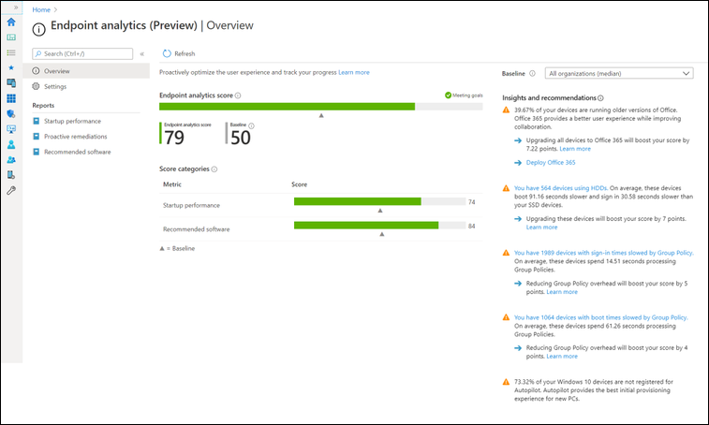
What is Endpoint analytics?
Notes:
Endpoint analytics aims to improve user productivity and reduce IT support costs by providing insights into how your organization is working and the quality of the experience you're delivering to your end users. Endpoint Analytics can help identify configuration or hardware issues that may be slowing down devices, provide recommended actions to remediate them and proactively make changes without disrupting end users or generating a help desk ticket.
Endpoint analytics is also a part of the Microsoft Productivity Score. The Productivity Score provides productivity data, insights, and recommendations for your end user's experience and your organization's overall technology experience.
The following screenshot displays the Endpoint analytics pane:

Slide 35
What is Windows Autopilot?
Windows Autopilot:
Reduces the time IT spends on deploying, managing, and retiring devices.
Reduces the infrastructure required to maintain the devices.
Maximizes ease of use for all types of end users.
Notes:
Windows Autopilot simplifies enrolling devices in Intune. You provide the enrollment details up front before the end user receives a new computer. The Windows Autopilot process runs immediately after powering on a new computer for the first time, enabling employees to configure new devices to be business-ready with just a few clicks. You can also use Windows Autopilot to reset, repurpose, and recover devices. Leveraging cloud-based services, you can automatically join devices to Azure AD, auto-enroll devices into MDM services, such as Microsoft Intune, restrict rights on the computer, auto-assign devices to configuration groups, and customize the Out-of-box-experience (OOBE) content to be specific for your organization.
By using a collection of cloud-based technologies, Windows Autopilot:
Reduces the time IT spends on deploying, managing, and retiring devices.
Reduces the infrastructure required to maintain the devices.
Maximizes ease of use for all types of end users.
From the user's perspective, it only takes a few simple operations to make their device ready to use. The only interaction required from the end user is to connect to a network and to verify their credentials. Everything beyond that is automated.

Slide 36
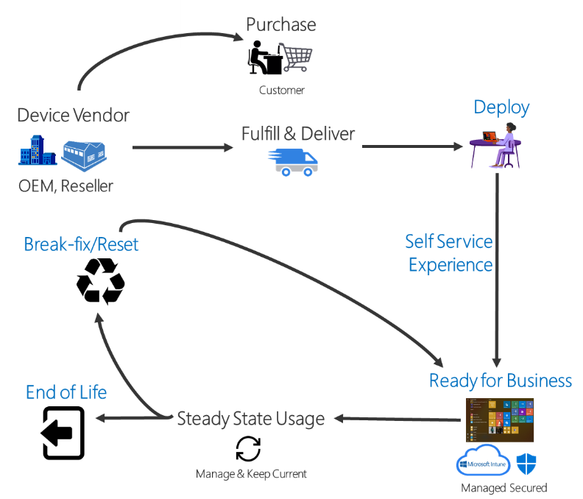
Windows Autopilot
Windows Autopilot to:
reset,
repurpose, and
recover devices.
Notes:
Windows Autopilot
Windows Autopilot is a collection of technologies used to set up and pre-configure new devices, getting them ready for productive use. Windows Autopilot can be used to deploy Windows PCs or HoloLens 2 devices. For more information about deploying HoloLens 2 with Autopilot, see Windows Autopilot for HoloLens 2.

Slide 37
Knowledge Check
What does Microsoft Endpoint Manager provide for an organization?
Endpoint Manager helps keep an organization's cloud and on-premises devices, apps, and data secure.
Endpoint Manager ensures an organization no longer needs credentials to access and share company data.
Endpoint Manager prevents remote devices and apps from accessing an organization's resources.
What are endpoints?
Endpoints are the policies that the users and groups of an organization use to safely transfer data.
Endpoints are the end-users of an organization.
Endpoints include mobile devices, desktop computers, servers, and apps that an organization uses.
What is co-management as it applies to Microsoft Endpoint Manager?
Co-management describes how an organization can concurrently manage Windows 10/11 devices using both Configuration Manager and Microsoft Intune.
Co-management describes how an organization can manage non-Windows devices at an organization using Microsoft 365, BitLocker, and Azure Active Directory.
Co-management describes how company owned devices can be managed without using cloud-based services.
Notes:
A
C
A

